Slide 1

Capstone Project

Slide 2



Personal BACKGROUND
Name : SANJAY M
Past Experience : Fresher
Qualification : BE-CSE
Career Summary : A recent graduate with backend development training that is extremely motivated and quick to pick things up. knowledgeable in MySQL, REST API, Spring Boot, Java, and has practical experience developing and testing scalable apps. completed a practical capstone project in microservices architecture, demonstrating proficiency in database administration and REST API development. during training, developed great communication and analytical skills.
www.collaberadigital.com

Slide 3


Used REST API and Spring Boot to migrate a monolithic design to microservices, putting an emphasis on bean creation and dependability. learned how to use Eureka Server for service discovery, microservice instance scalability, and server tracking.
Key Takeaways/Learnings from the Program (HTD)
Learned about LTS Java versions and Developed writing skills for JUnit tests.
Developed apps that are freely connected within a monolithic design and microservices.
Used REST API and Spring Boot to migrate a monolithic design to microservices, putting an emphasis on bean creation and dependability also learned how to use Eureka Server for service discovery, microservice instance scalability, and server tracking.
Used EC2 to deploy Eureka Server and microservice instances on AWS and learned about Windows File System (WFS) and Network File System (NFS).
Investigated architecture based on interfaces. Config Server for Spring Cloud was learned about.
Soft Skills

Slide 4

Problem Statement of the Capstone Project
Create a practical project that will allow administrators to handle passenger reservations, airline information, and airport facts. The system uses Spring Boot to create microservices.
Microservice Applications must have the following:
Airport Application
Booking Application
Login Application
Passenger Application
Plane Application
Schedule Application
The main features include search capabilities, CRUD operations for managing airports, aircraft, and reservations, and login authentication.

Slide 5
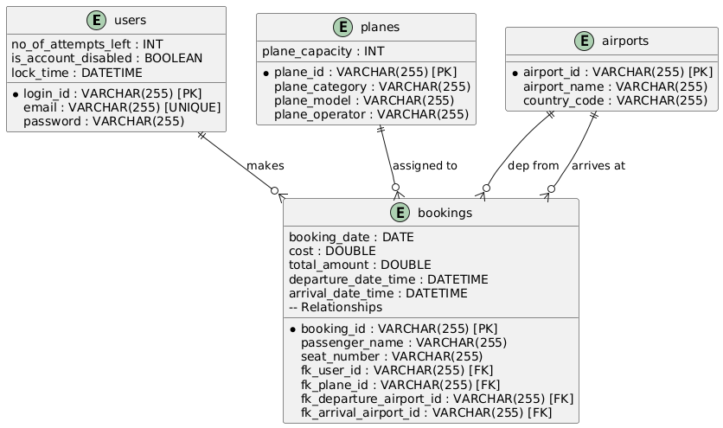
ENTITY-RELATIONSHIP DIAGRAM

Slide 6
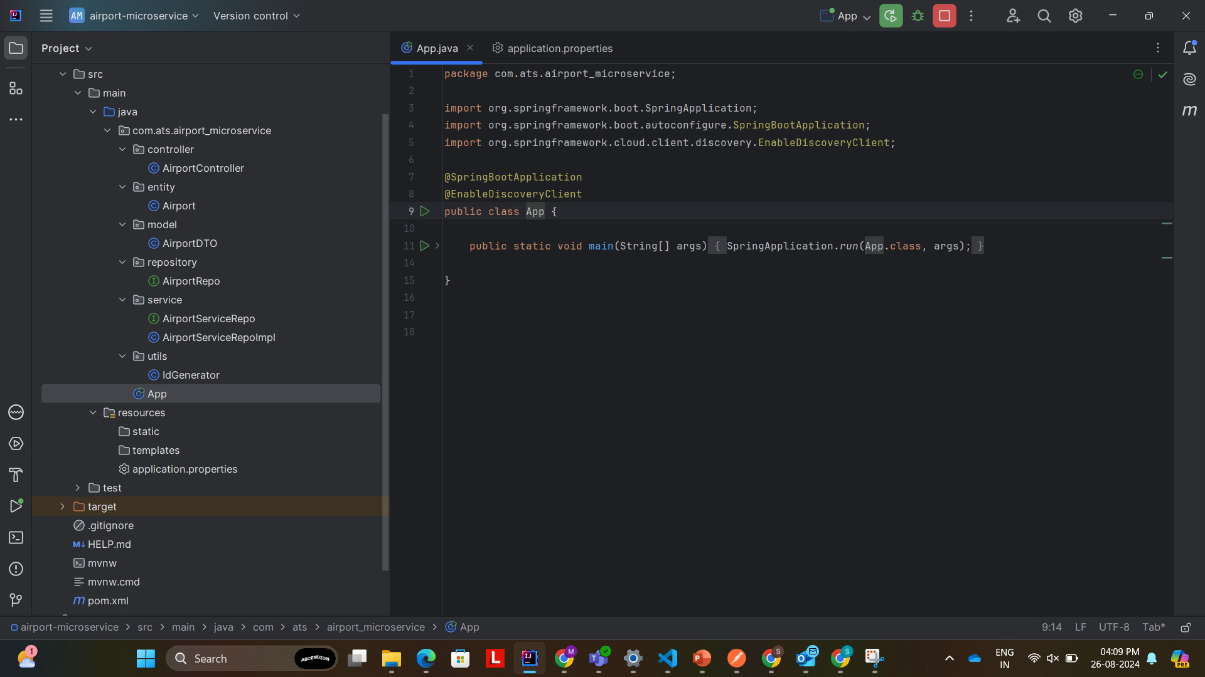
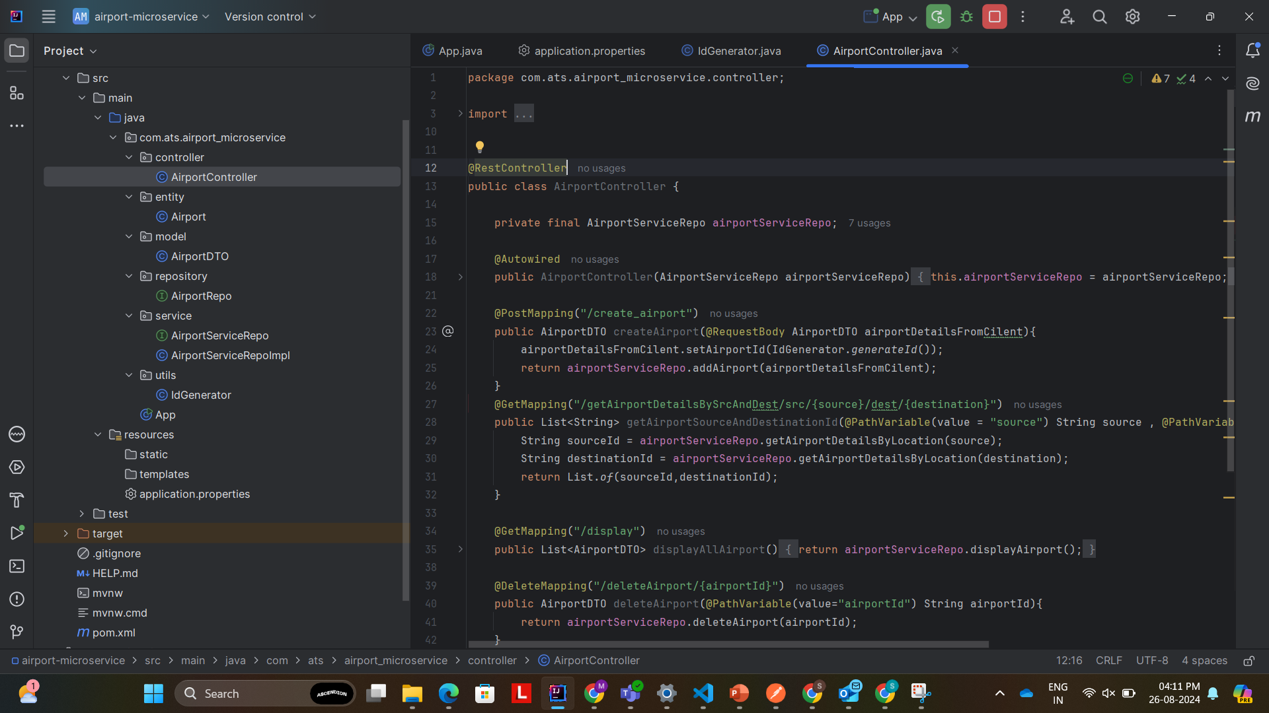
Microservice project with screenshots and structure
AIRPORT MICROSERVICES

Slide 7
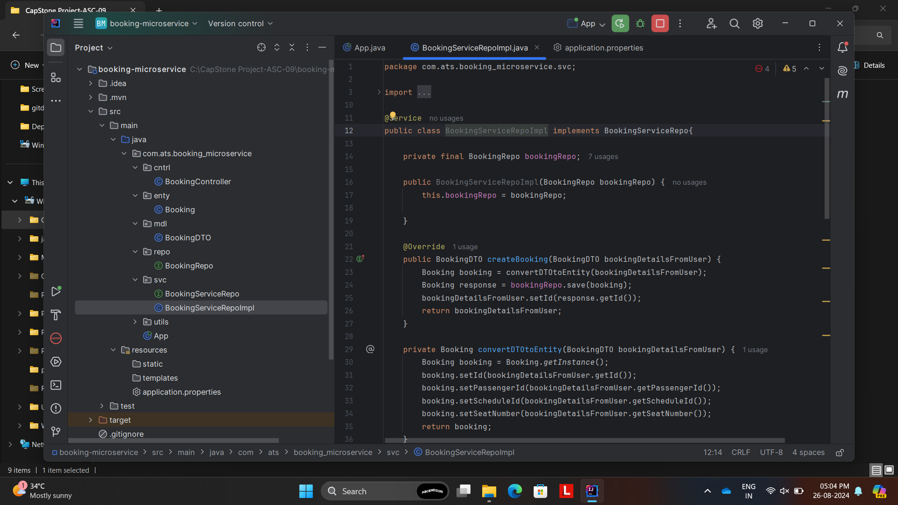
Microservice project with screenshots and structure
BOOKING MICROSERVICES

Slide 8
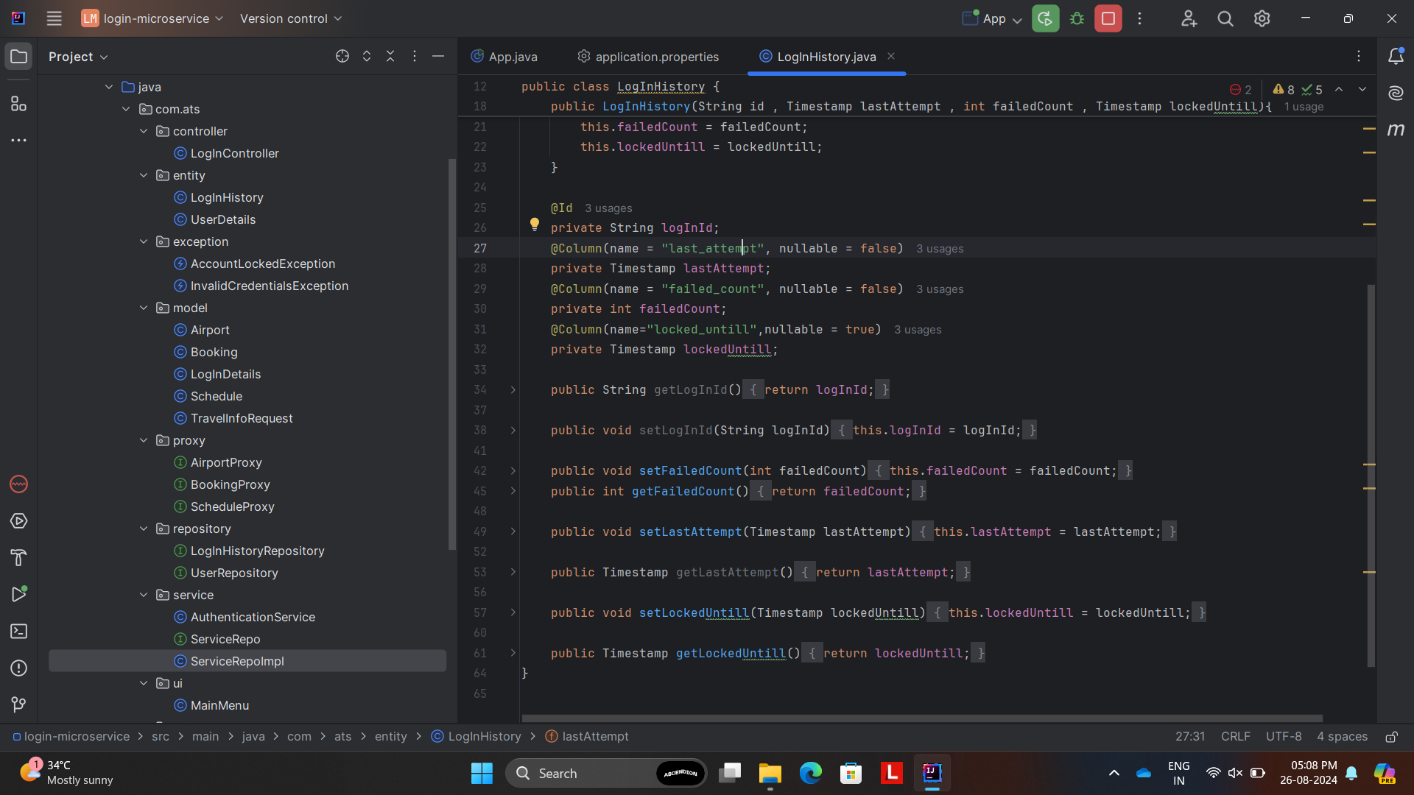
Microservice project with screenshots and structure
LOGIN MICROSERVICES

Slide 9
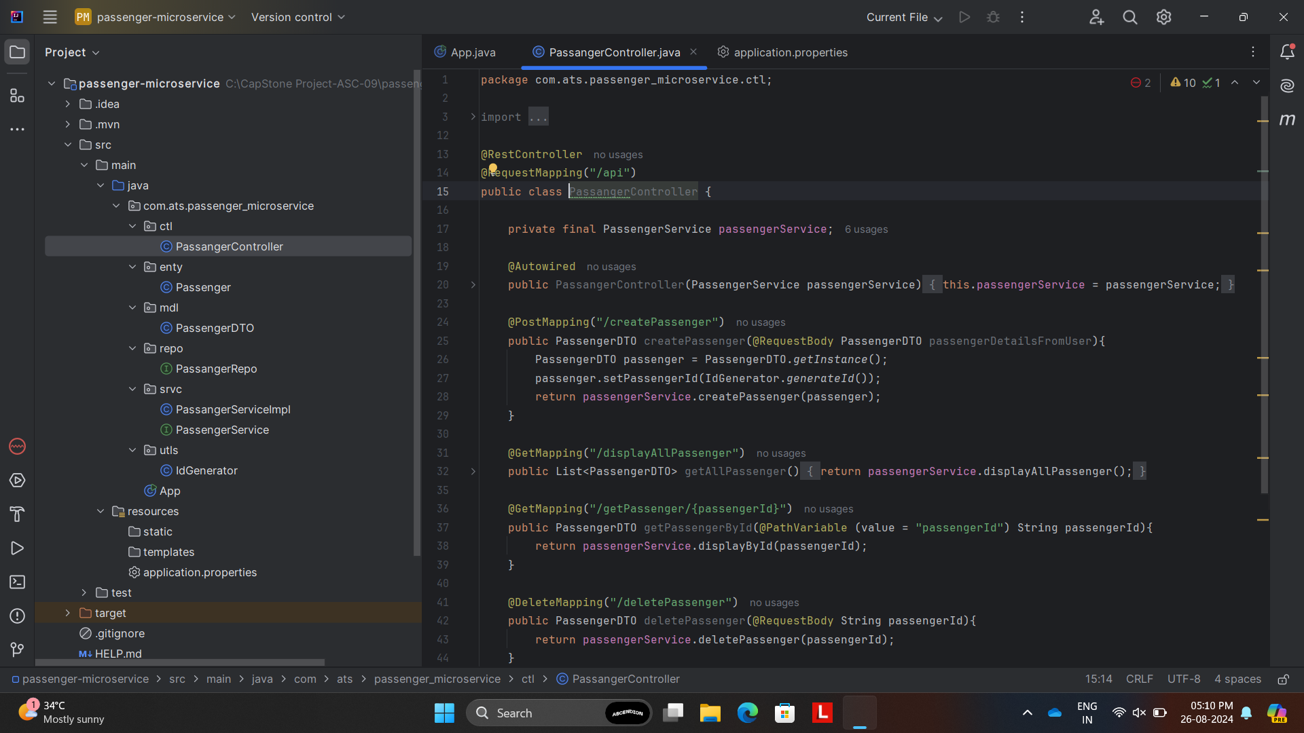
Microservice project with screenshots and structure
PASSENGER MICROSERVICES

Slide 10
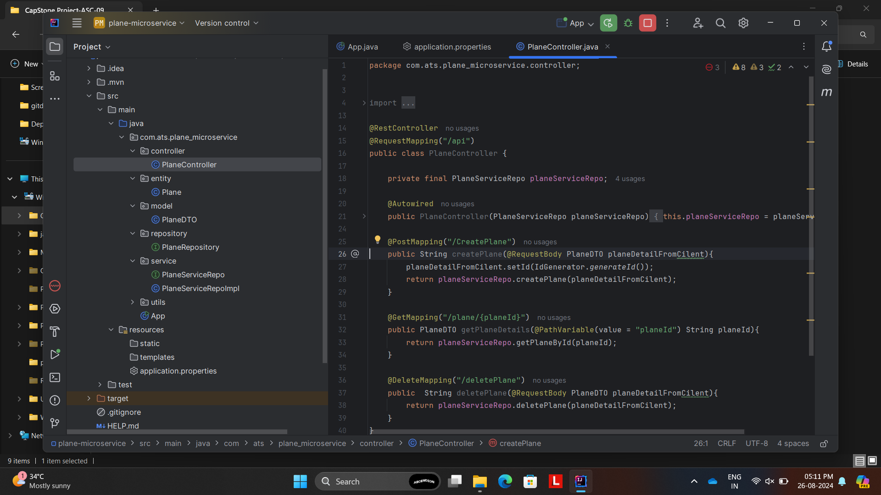
Microservice project with screenshots and structure
PLANE MICROSERVICES

Slide 11
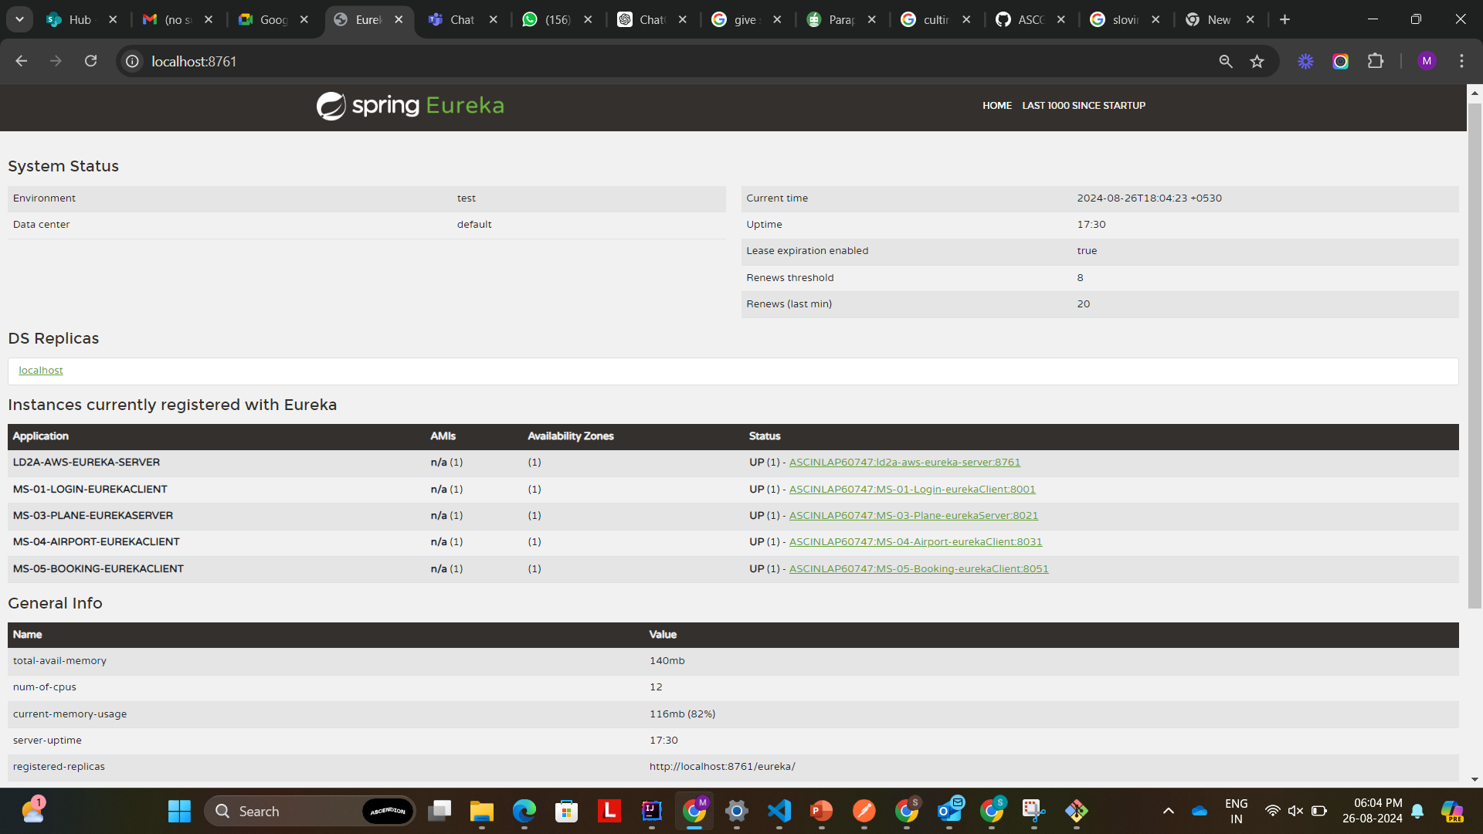
EUREKA SERVER

Slide 12
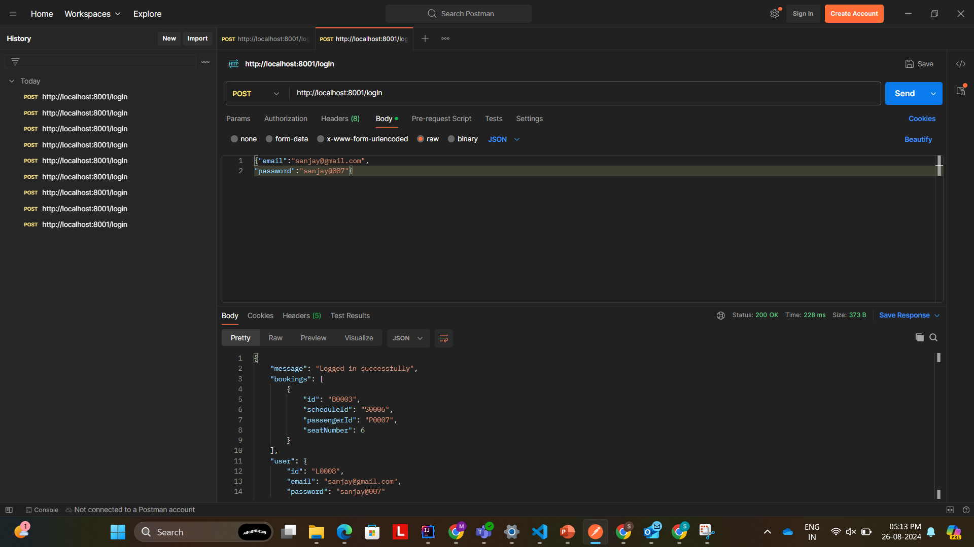
POSTMAN

Slide 13
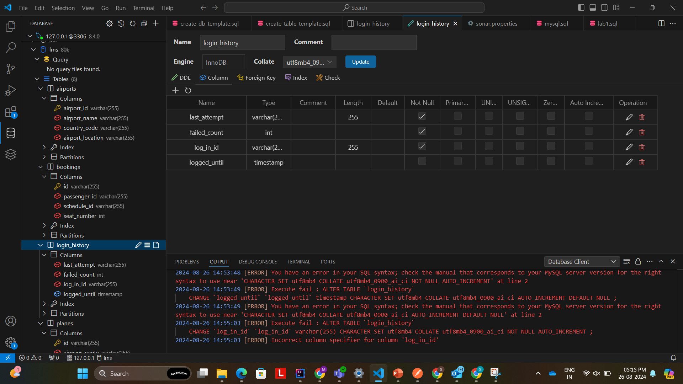
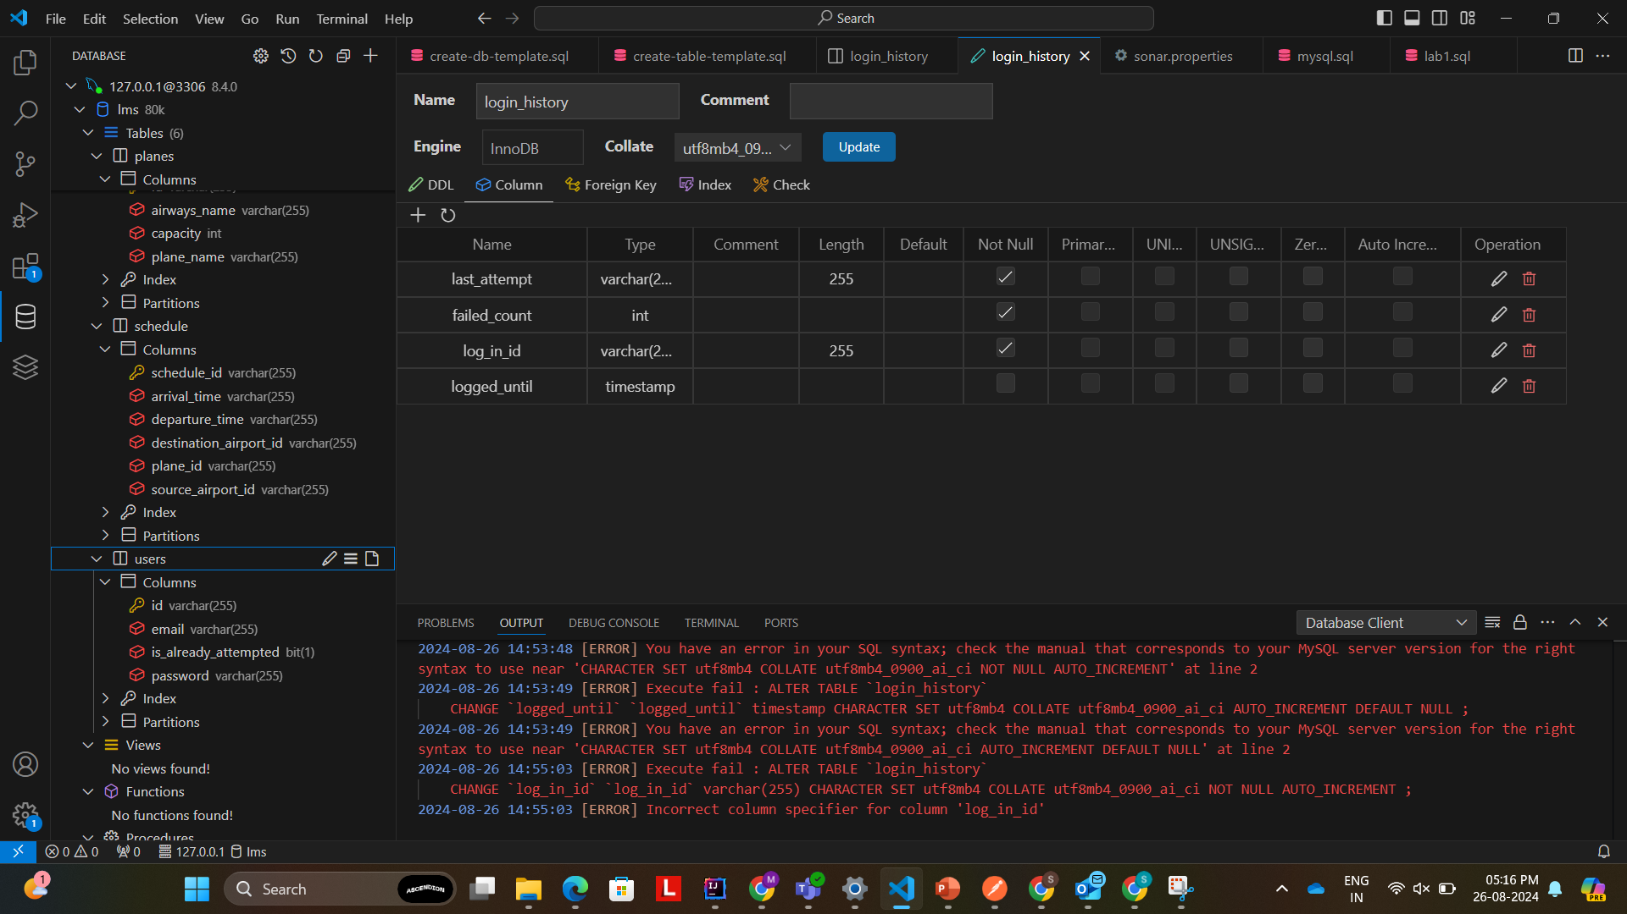
DATABASE

Slide 14
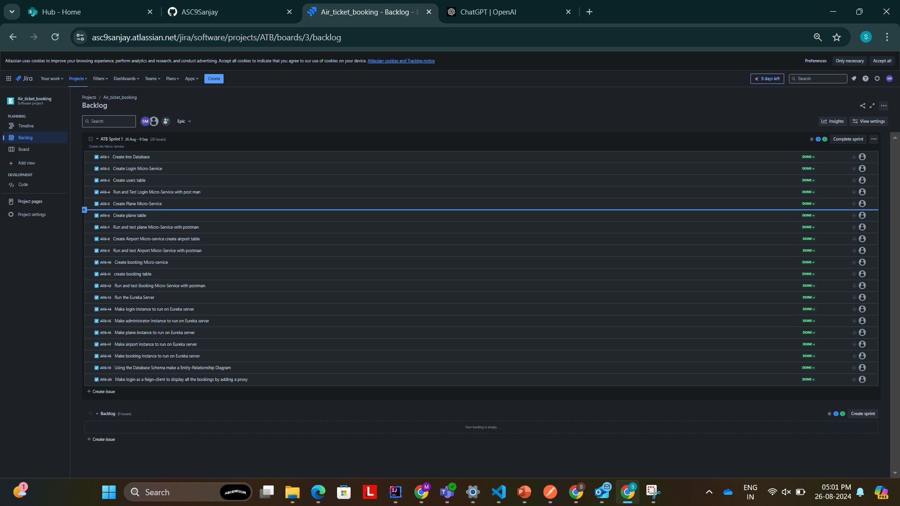
JIRA

Slide 15
Conclusion
Using Spring Boot, the Air Transport System provides a backend solution for controlling air transport operations. It guarantees the effective management of essential features, including full CRUD operations for reservations, aircraft, airports, and user authentication. The project serves as an example of how to use Hibernate, REST API, Maven, JPA, and Spring Boot effectively. The project includes a number of microservices, such as booking, airport, plane, and login services. Each microservice is specifically built to perform a certain job and is smoothly integrated into the system to produce a strong system.

Slide 16
Thank You

